Slide 1
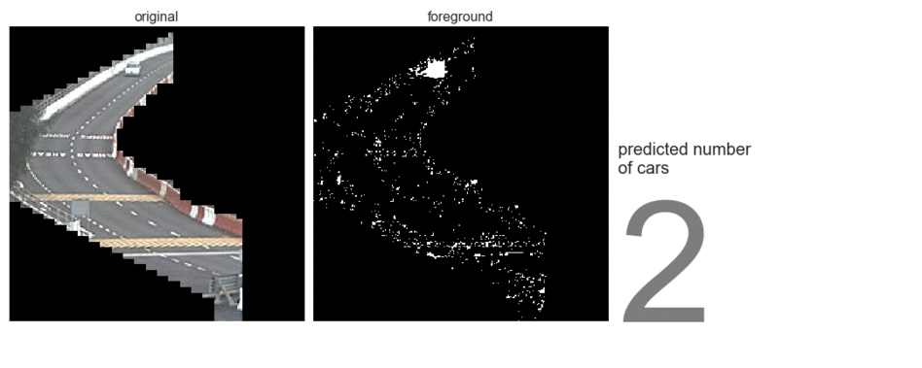
Traffic Image Analysis
Extracting real-time traffic volume

Slide 2
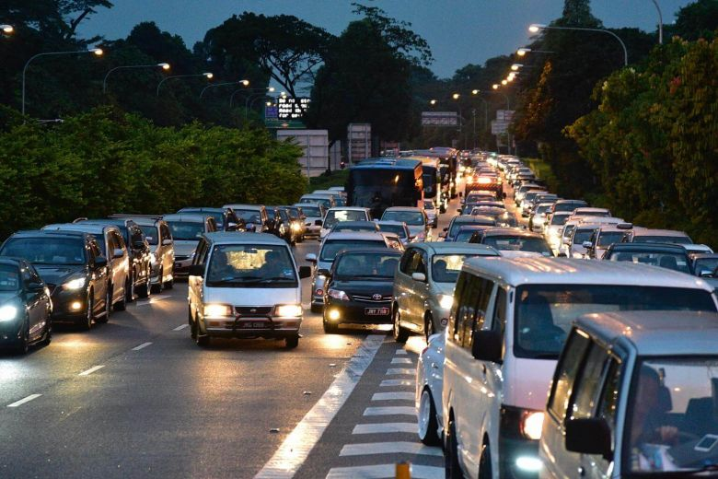
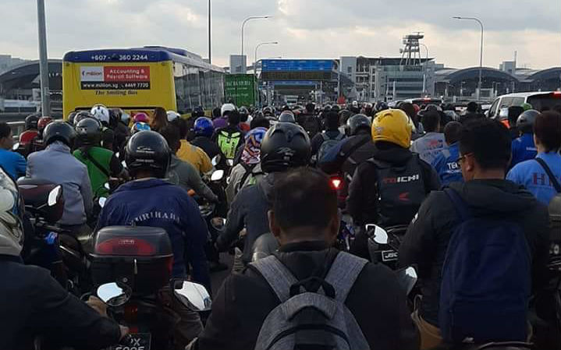
Problem Statement
Jams at the Woodlands and Tuas checkpoints are a frequent occurrence
Picking the wrong time or checkpoint to travel can mean hours wasted in traffic
Images:
https://www.straitstimes.com/singapore/travellers-endure-long-waits-at-tuas-and-woodlands-checkpoints-over-the-weekend
https://coconuts.co/singapore/news/tuas-checkpoint-ica-traffic-jam-motorists-several-hours-johor/

Slide 3
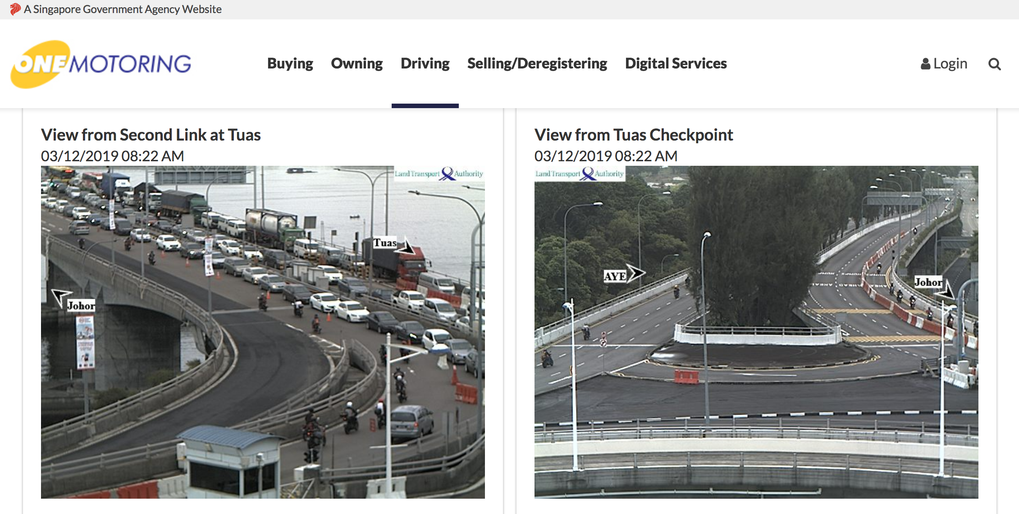
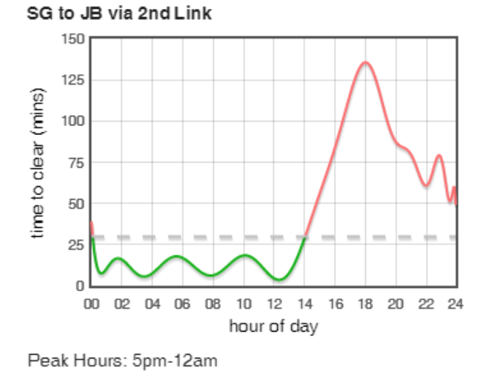
Currently available resources
Websites that display static images from the same traffic cameras API offered by LTA
No information about trend
"Beat the Jam" app uses Google Maps API
Depends on crowd-sourced data; not always accurate

Slide 4
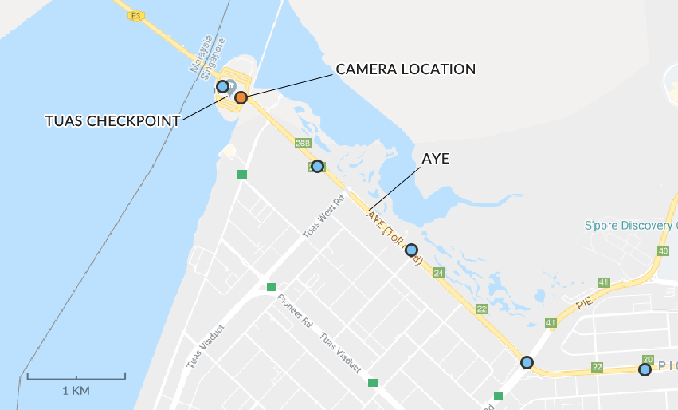
Data
LTA’s traffic cameras API
~1 image per minute

Slide 5
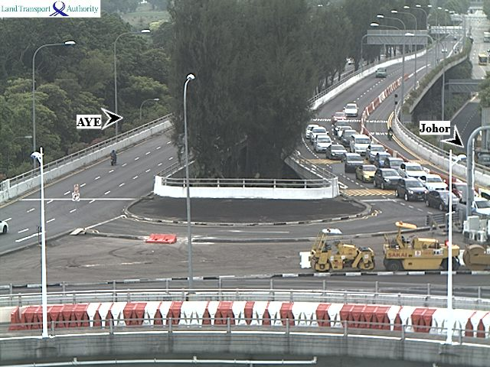
Image limitations
Low resolutions
(640 x 480)
Occlusion

Slide 6
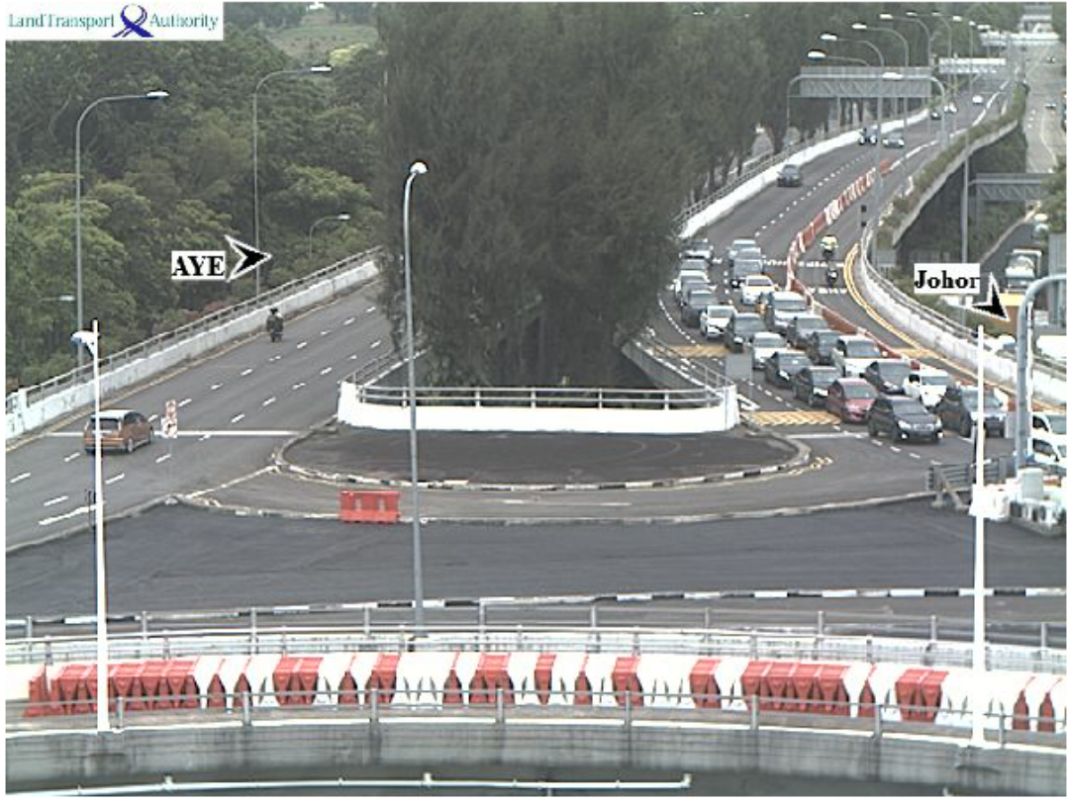
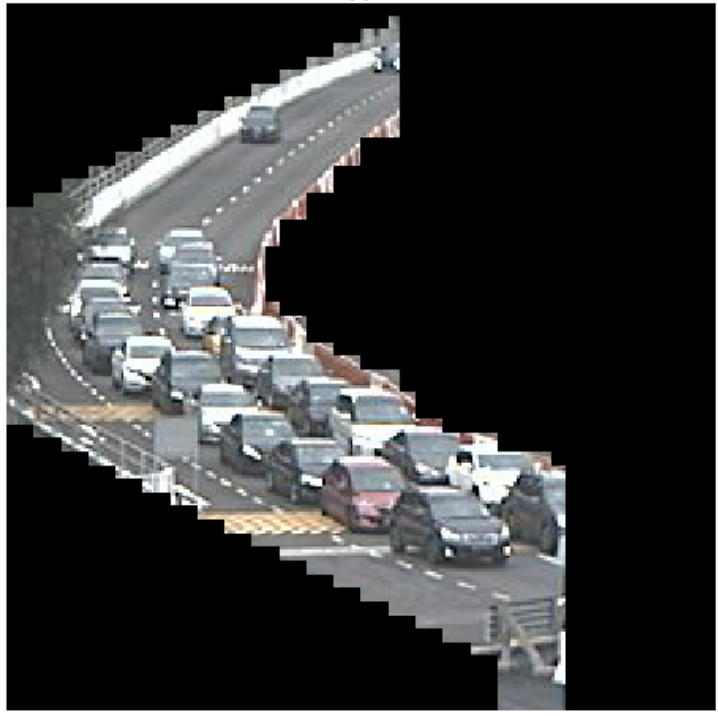
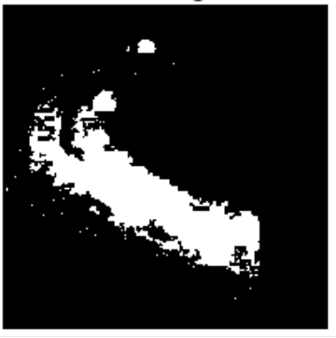
Preprocessing
Model input
Original
Cropped
Background subtraction
>
>

Slide 7
Modelling approach
“How congested?”
“How many cars?”
Classification (Machine learning)
>
Classification (Deep learning)
>
Regression (Deep learning)
>
Regression (Machine learning)
Model | Validation accuracy
Logistic regression | 0.90
KNN | 0.93
Decision tree | 0.91
Model | Validation accuracy
9-layer CNN | 0.98
Model | Validation MAE
11-layer CNN | 3.89
12-layer Convolutional LSTM | 3.98
11-layer ConvLSTM | 5.85
Model | Validation MAE
Linear regression | 4.58
Decision tree | 5.58
XGBoost* | 4.42
*production model

Slide 8
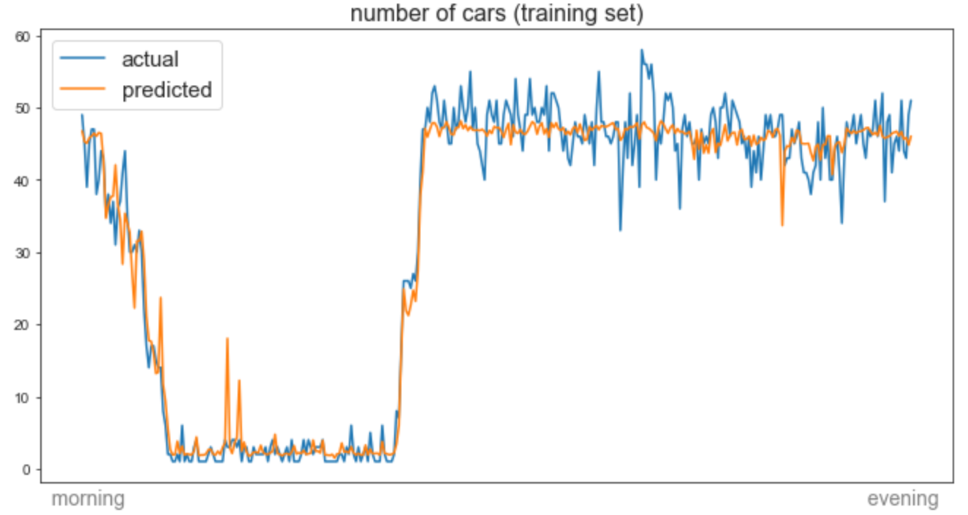
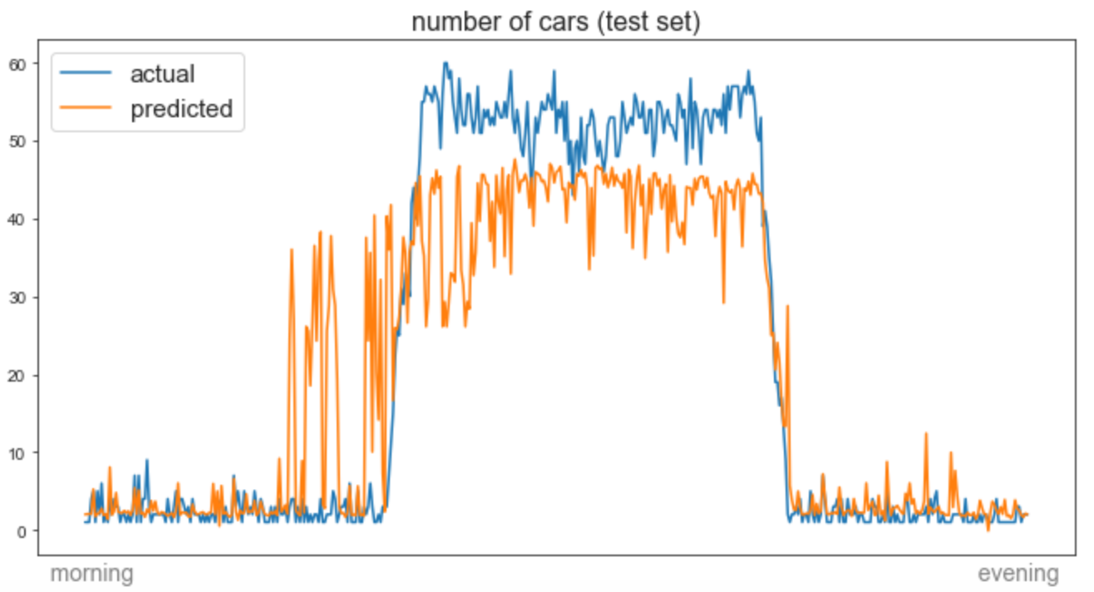
Modeling results
Error
(MAE) = 2.5 cars
Error
(MAE) = 6.6 cars
MORNING → EVENING

Slide 9

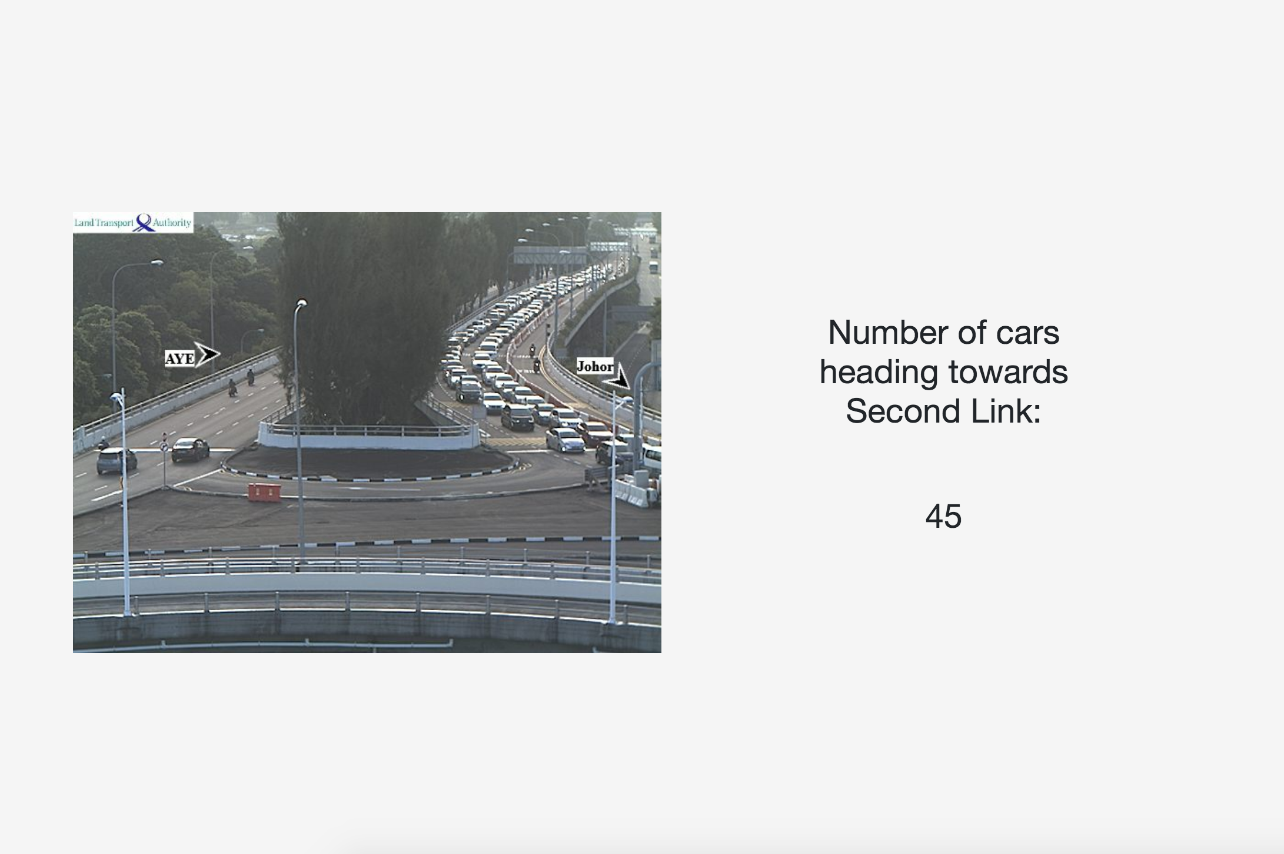
Deployment
UI
LTA API
1 minute
intervals
Images
Scraping app
Web app
Images
Images
Heroku PostgreSQL server

Slide 10
Conclusion & recommendations
The current model provides a direct estimation of road congestion in contrast to the proxy-based algorithm used by Google Maps.
However, the current model lacks the ability to estimate travel times.
To make better recommendations to commuters, the two approaches should be combined.
Not limited to traffic at checkpoints
Crowd counting
Wildlife census
Enumerating cells

Slide 11

Thank you -
LinkedIn
Instructors and friends of DSI10 for the past 12 weeks!

Slide 12
Extra slides

Slide 13
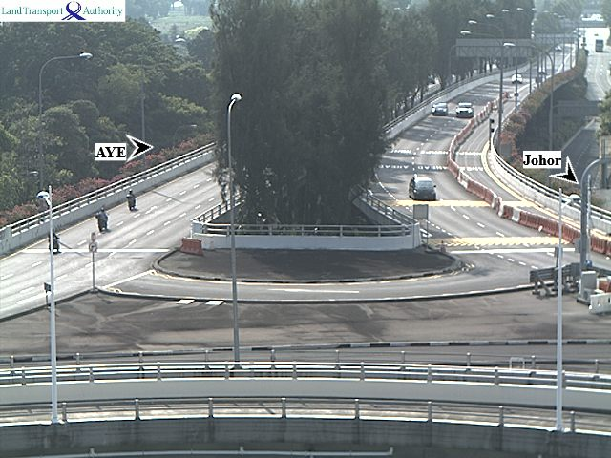
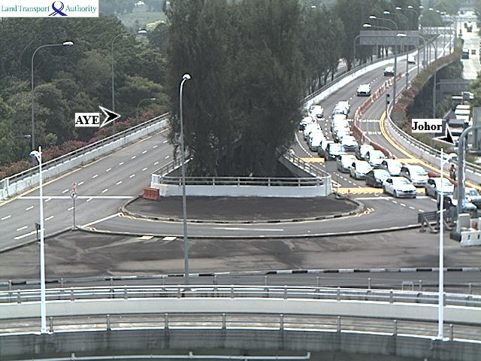
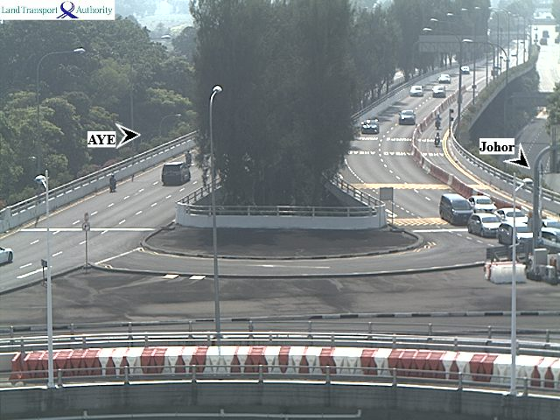
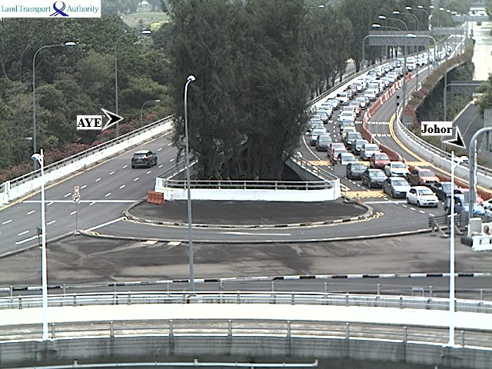
Step 2: regression
How many cars?
Notes:
Expand into a regression problem: predicting number of cars in an image.
To do this I needed labelled images with the number of cars.

Slide 14
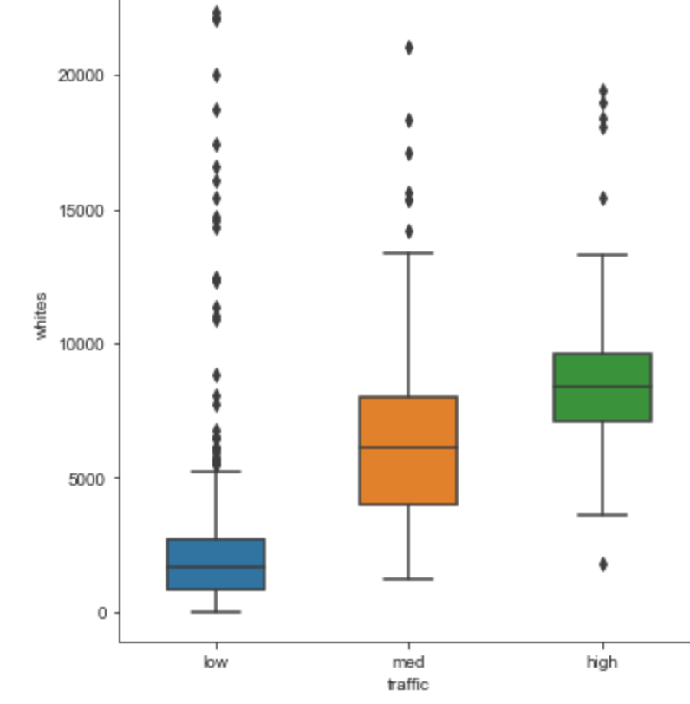
EDA
White pixels
low medium high
Notes:
To decide on the modelling approach I looked at whether the white pixels (foreground) is different for each category

Slide 15
Model Architecture Convolutional LSTM
time_distributed_1: TimeDistributed(Conv2D)
time_distributed_2: TimeDistributed(MaxPooling2D)
time_distributed_3: TimeDistributed(Conv2D)
time_distributed_4: TimeDistributed(MaxPooling2D)
time_distributed_5: TimeDistributed(Conv2D)
time_distributed_6: TimeDistributed(MaxPooling2D)
time_distributed_7: TimeDistributed(Conv2D)
time_distributed_8: TimeDistributed(MaxPooling2D)
time_distributed_9: TimeDistributed(Flatten)
lstm_1: LSTM
dense_1: Dense
dense_2: Dense

Slide 16
Step 1: classification
Low traffic
Medium traffic
High traffic
Notes:
Low: no queues
Medium: queues starting to form, but not yet covering entire road
High: queue covers the whole road area in the camera

Slide 17
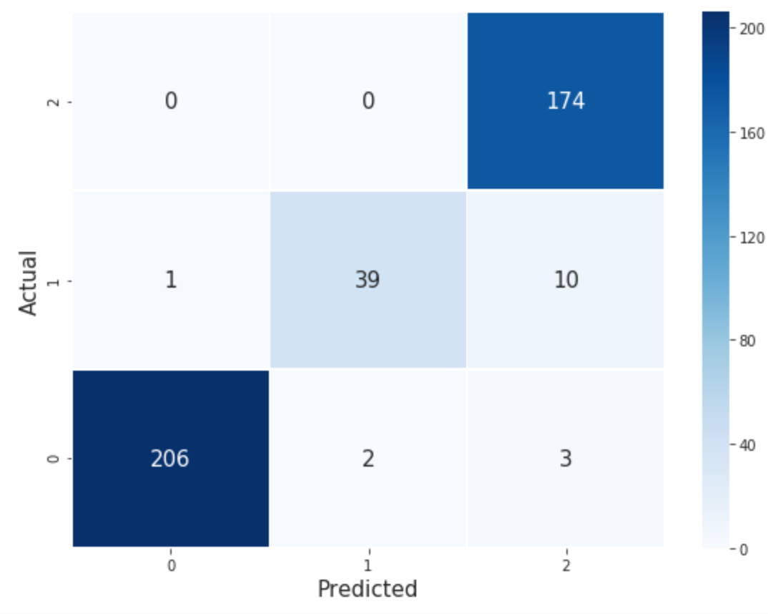
CNN
Accuracy: 96%
Notes:
Middle values are correct predictions

Slide 18
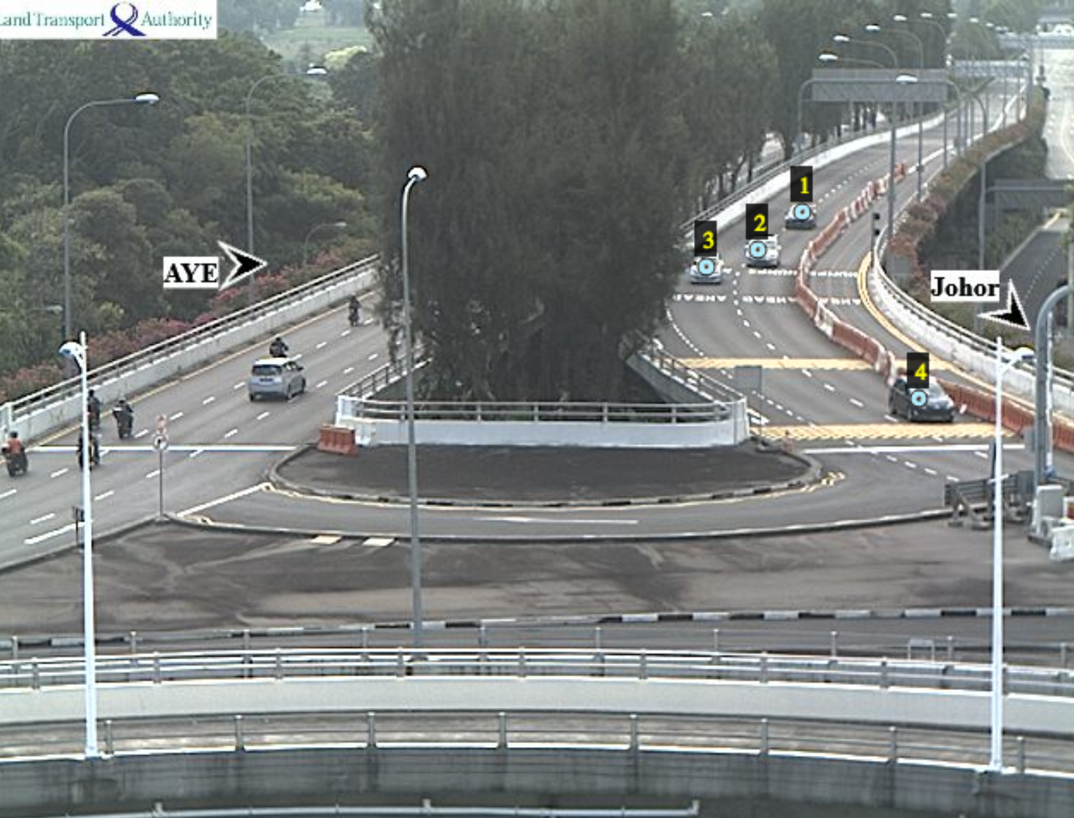
Labeling

Slide 19
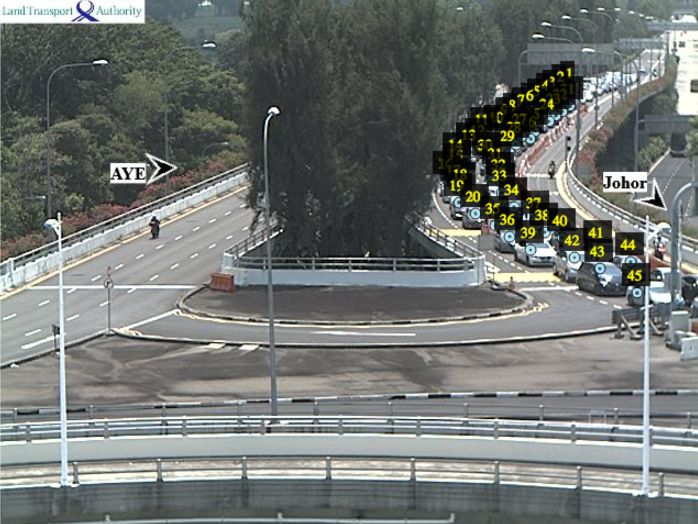
Labeling

